Slide 1

INTELLI DOMOTICS
CB.SC.U4AIE24103- Ananya
CB.SC.U4AIE24119- Kiranmai
CB.SC.U4AIE24120- Sudeshna
CB.SC.U4AIE24163- Devi Sri

Slide 2
Intelli Domotics harness IoT (Internet of Things) technologies to enhance convenience, safety, and automation. Intelli Domotics is a real-time smart home solution that focuses on monitoring sensor data and providing instant suggestions or responses based on detected conditions. By integrating multiple sensors and devices through IoT, Intelli Domotics offers users efficient device control, live feedback, and custom automation rules for a more responsive and interactive living environment. It’s a scalable and practical system aimed at making home automation more accessible and user-driven.
INTRODUCTION

Slide 3
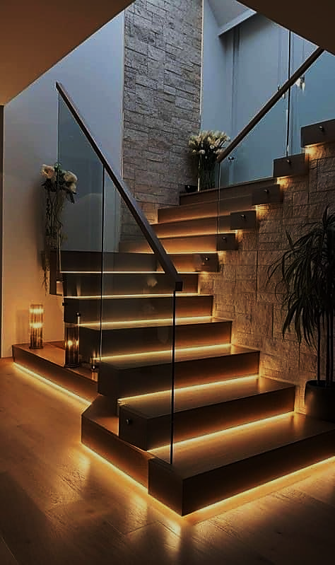
To design and implement an IoT-based smart home system that allows users to monitor and control household devices in real time through a centralized interface.
To enable real-time data collection and monitoring from various home sensors (such as temperature, motion, light, etc.) to improve situational awareness and convenience.
To provide instant, actionable suggestions or responses based on current sensor values, helping users make informed decisions for home management.
To create a flexible and user-friendly platform that allows users to add devices, set up custom automation rules, and visualize device status dynamically, all without requiring AI or predictive analytics.
OBJECTIVES

Slide 4
ICMED 2024 paper Lacks manual override; user cannot intervene during automation.
Requires constant connectivity increasing complexity and cost.
Our project uses real-time rule-based control with sensors (LDR, DHT22, IR).
Includes manual fan control, ensuring safety and user preference.
Fully functional offline, with local automation.
LITERATURE REVIEW
Home Automation using Artificial Intelligent & Internet of Things, ICMED 2024, MATEC Web of Conferences.

Slide 5

METHODOLOGY

Slide 6
Garage
An IR sensor is placed at the garage entrance to detect the presence of a vehicle or object.
When the IR sensor detects an object, a 2-second delay is applied before the servo motor is triggered to open the garage shutter.
If the sensor detects no object afterward, a 4-second delay is applied, and the servo motor rotates back to close the shutter automatically.
The entire logic is handled by an Arduino Uno, which receives sensor input and controls the servo motor.
The system continuously sends status updates directly to the web interface using Arduino, allowing real-time garage door monitoring and manual override.

Slide 7
ROOM-1
An LDR (Light Dependent Resistor) continuously senses the room's ambient light level.
The Arduino Uno reads the analog LDR value to determine brightness.
If light intensity falls below a defined threshold, the LED (filament bulb) is turned ON.
If brightness is above the threshold, the LED is turned OFF.
The current LDR value and LED status are sent from Arduino UNO, updating the web interface in real time.

Slide 8
ROOM-2
A DHT22 sensor continuously monitors temperature and humidity in the room.
Sensor data is sent to the Arduino Uno, which forwards it to the Flask backend.
Based on temperature:
  If it's above the comfort threshold, a suggestion to turn ON the fan is shown on the web interface.
  If it's cool enough, a suggestion to keep the fan OFF is displayed.
The fan (DC motor) is controlled manually using a physical switch.
The web interface displays real-time sensor values, current fan status, and suggestions — but does not auto-control the fan.

Slide 9
RESULTS AND ANALYSIS

Slide 10
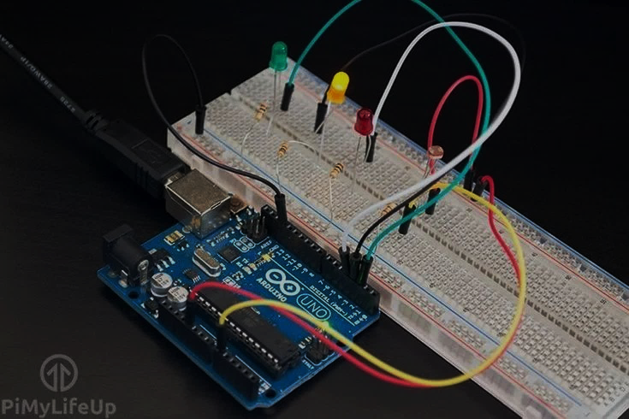
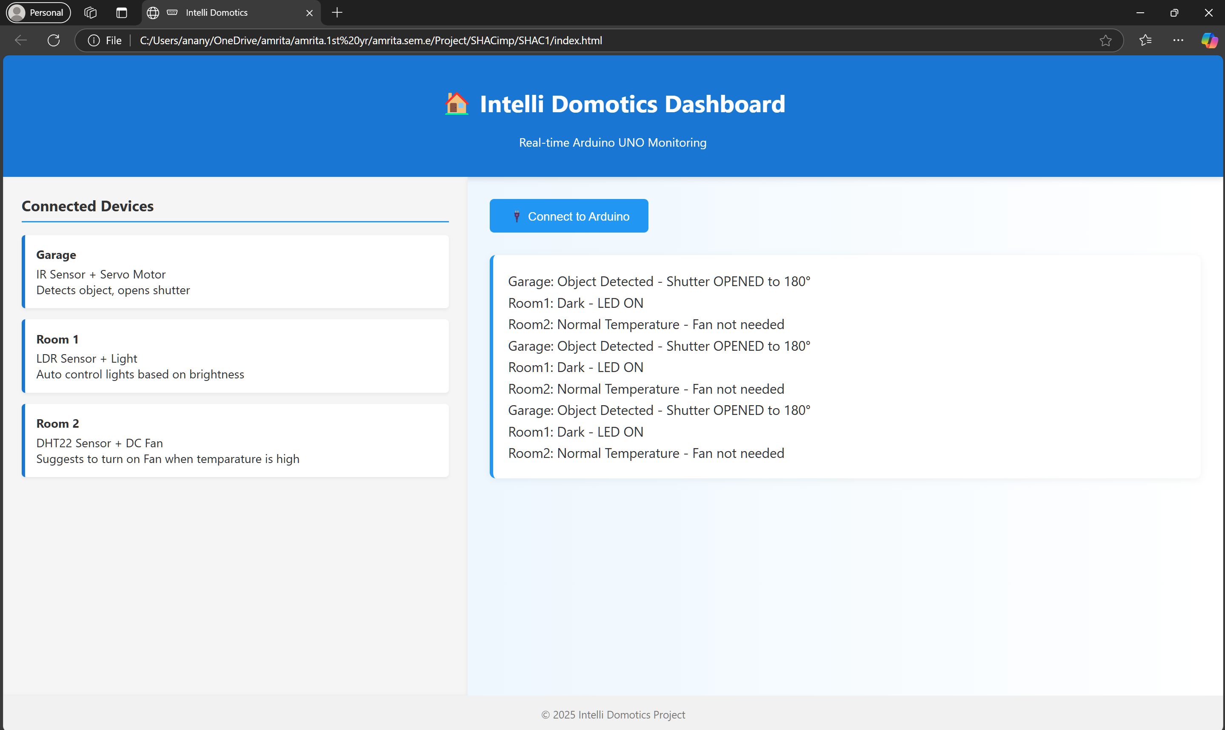
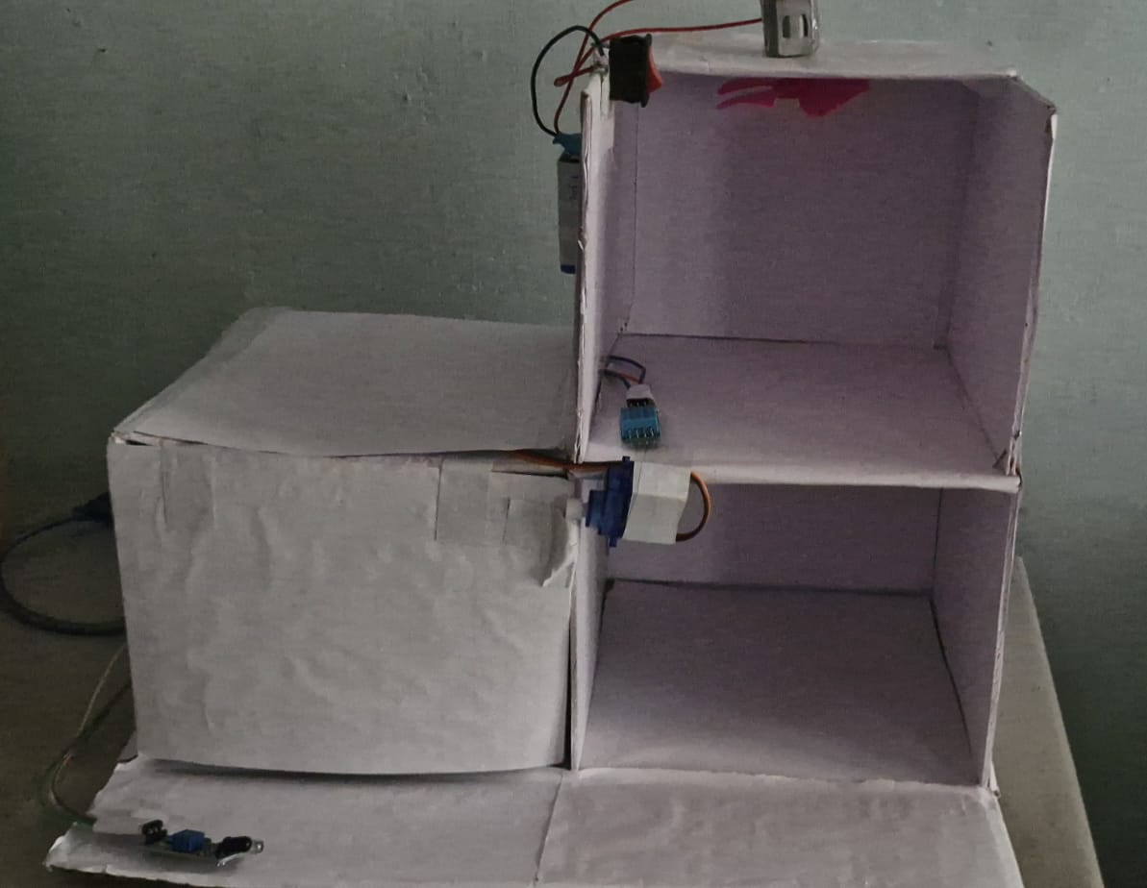
USER INTERFACE
HARDWARE

Slide 11
Overall work Flow
Sensors collect data (IR, LDR, DHT22) from each room and garage.
Arduino Uno processes data and controls devices:
  Opens/closes garage shutter (IR + Servo)
  Turns LED ON/OFF (LDR)
  Suggests fan usage (DHT22)
Data is directly sent to the web interface.
Users view real-time status and follow suggestions (fan via manual switch).

